Slide 1


Slide 2

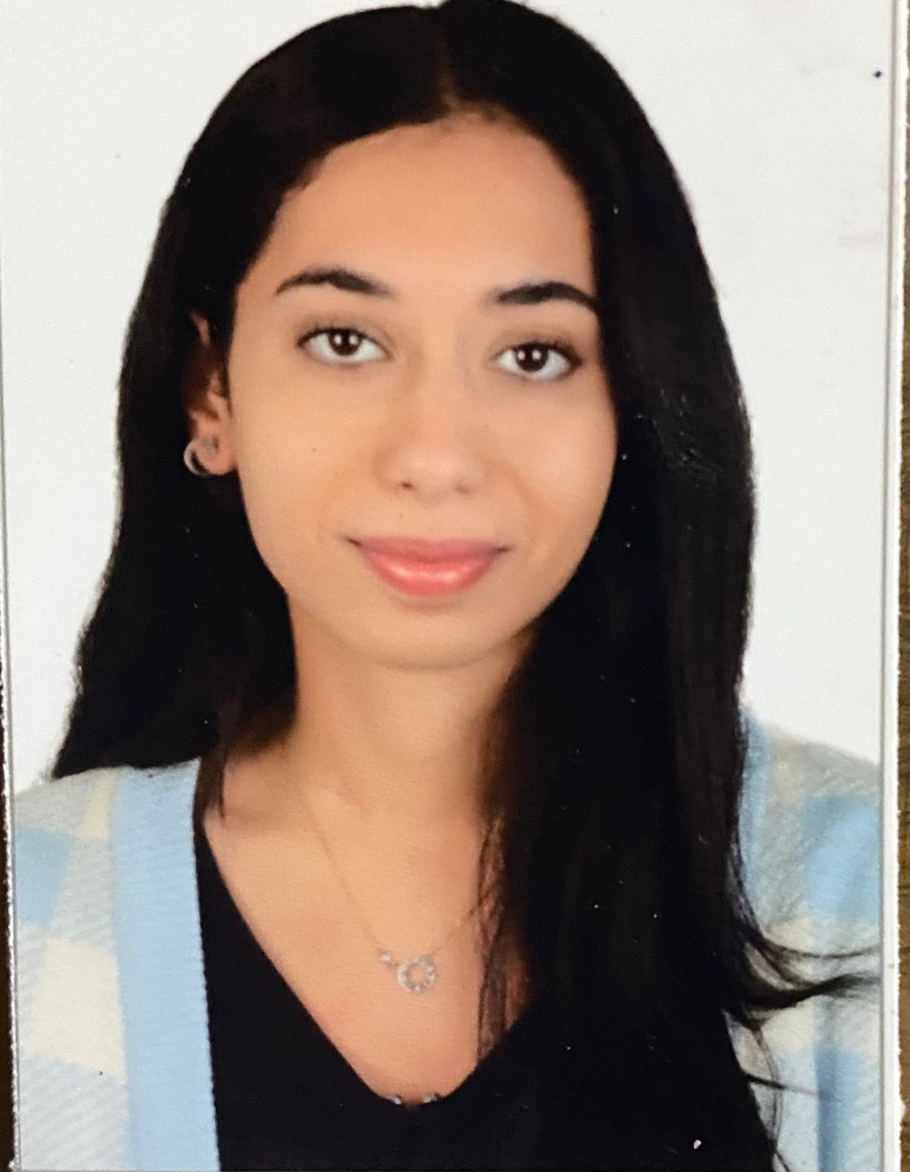
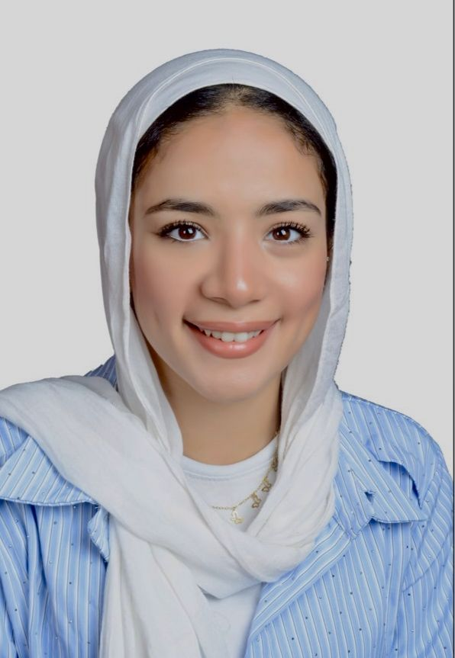
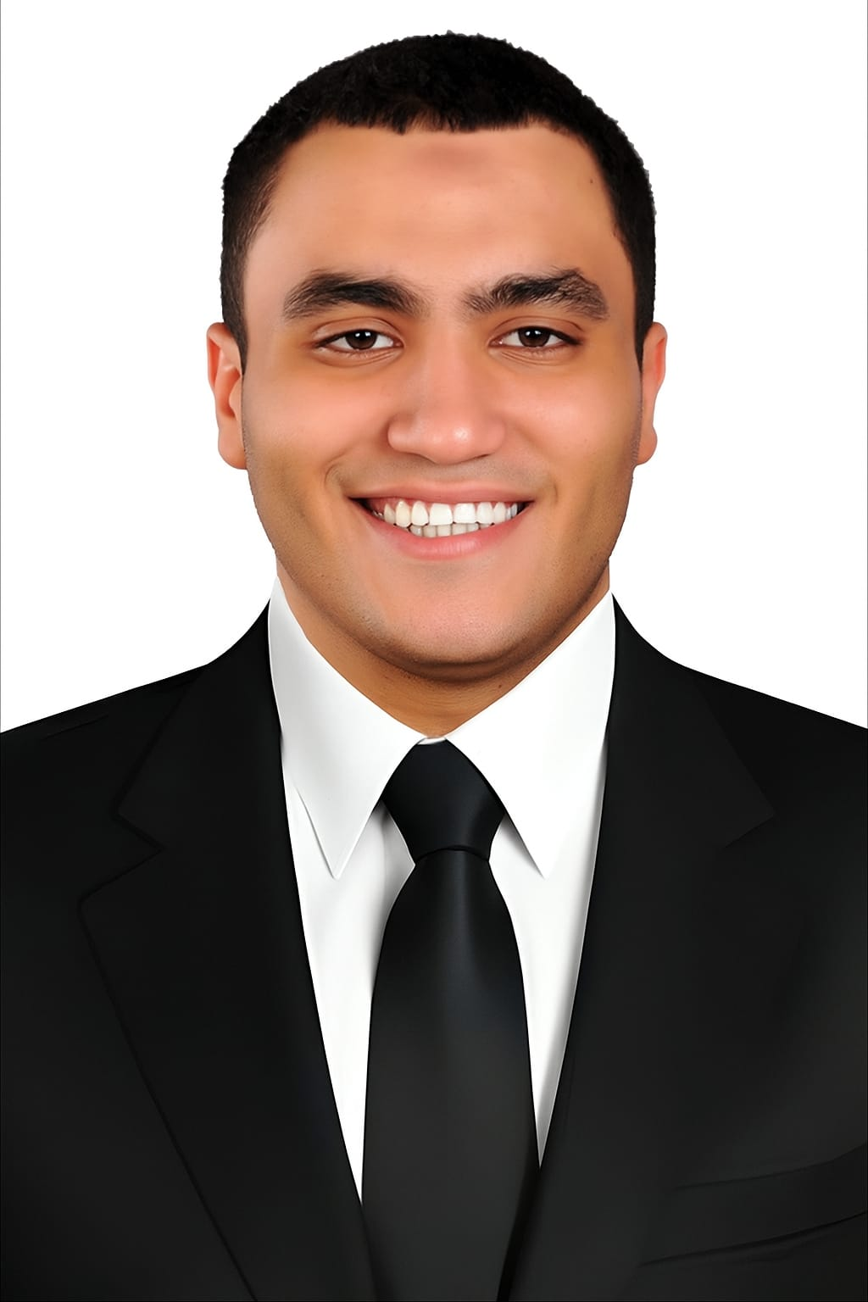
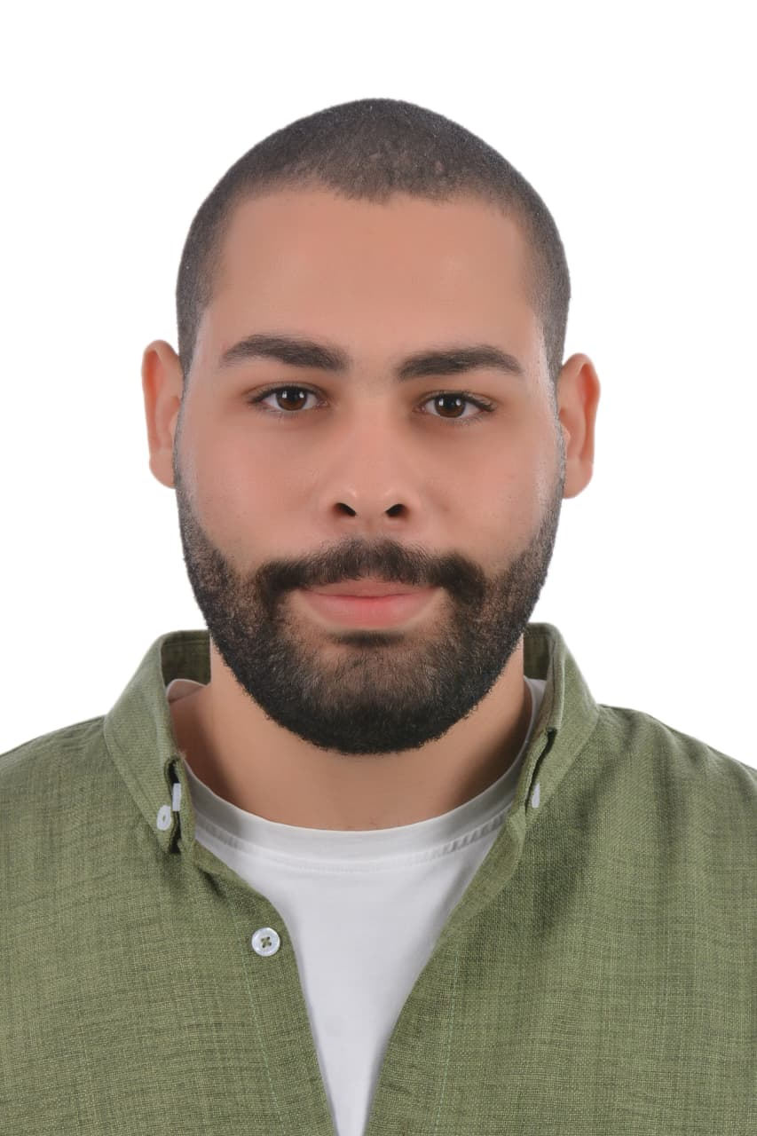
Our team
Bassant Mohamed
Farouk Ashraf
Team Leader
Mahmoud Hany
Farah Hisham
Mohamed Ahmed

Slide 3
Introduction
This data analysis project seeks to move beyond evidences and provide a
clear, data-driven perspective on the state of Egypt’s workforce. By
systematically collecting, cleaning, and analyzing relevant datasets from
national labor force surveys and educational statistics to economic
indicators and private sector reports, and presenting the insights by the
storytelling technique, as we aim to uncover the underlying patterns and
trends shaping employment in Egypt.

Slide 4
Who is Our Stakeholders?
The Ministry of Manpower: Directly concerned with employment rates, labor market regulations, and skill matching between citizens and available jobs.
The Ministry of Education & Technical Education: Centrally concerned with aligning educational outcomes with labor market needs, ensuring graduates possess the skills demanded by the modern economy.

Slide 5
Our Steps for analyze the data:
1- Data Collection
2- Data Cleaning & Processing
3- Data Integration
4- Data Analysis
5- Data Visualization

Slide 6
Data Collection

Slide 7
Data Collection
Data Source: The data was collected from the official website of the Central Agency for Public Mobilization and Statistics (CAPMAS) and The Egyptian Center for Economic studies (ECES).
Our Data: Population Census and Housing Conditions (Extended Form)Governorates Issue: May 2019
Economic Statistics Handbook of the Arab Republic of Egypt Issue: 2025
UNVEILING THE SECRETS OF FREELANCING SUCCESS: COMPARATIVE STUDY OF EGYPT AND INDIA

Slide 8
Data Processing & Cleaning

Slide 9
Data Processing & Cleaning
1- Format Conversion
-Converted the dataset from an unanalyzable format (PDF) into
analyzable formats (Excel/CSV).
-Ensured all tables and numeric data were correctly extracted.
2- Error Correction & Standardization
-Fixed data entry errors, missing values, and format inconsistencies.
-Standardized column names and ensured uniform data types for analysis.

Slide 10
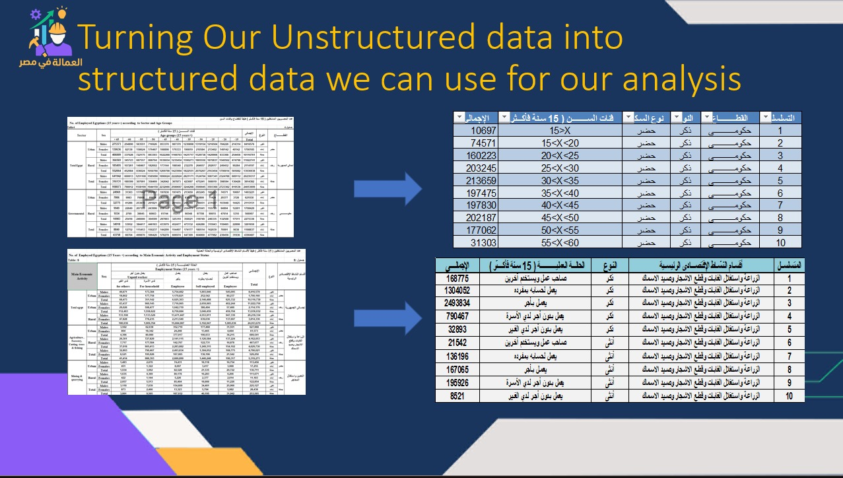
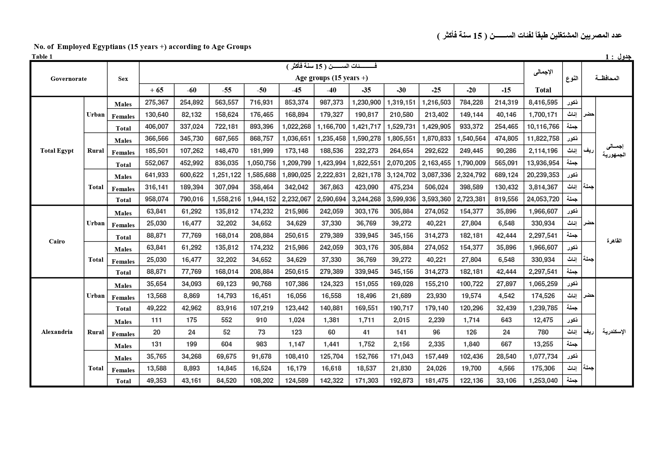
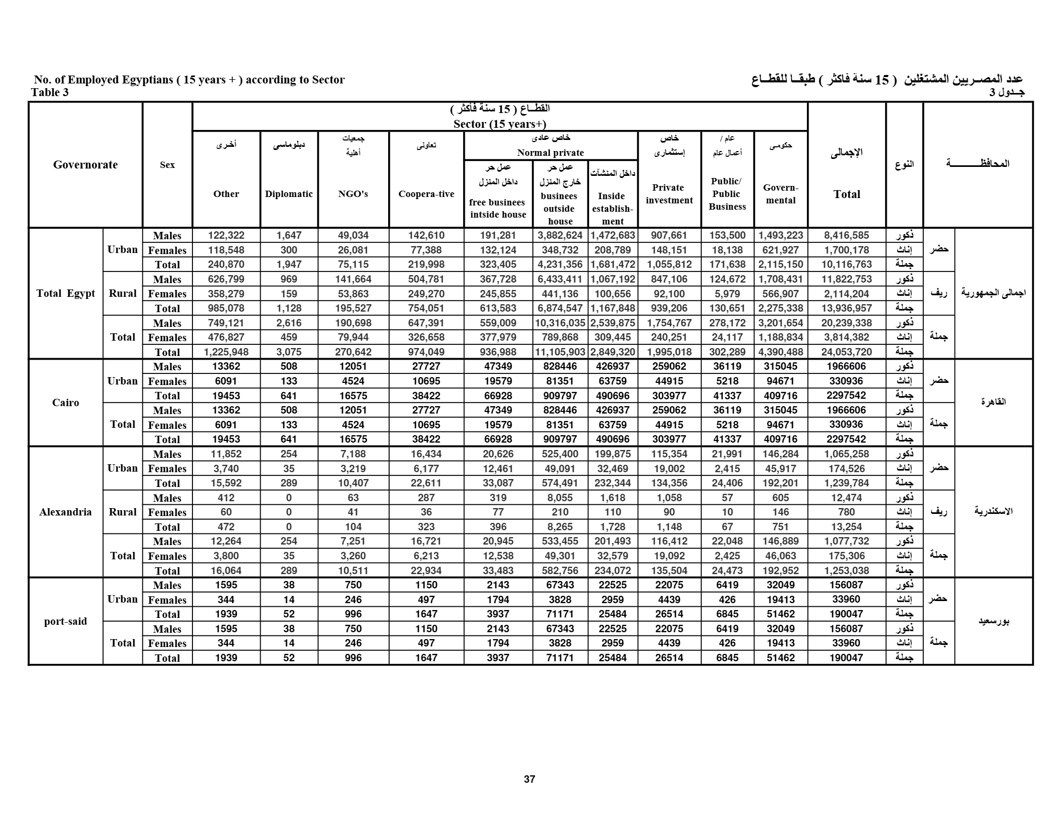
Our samples for the Format Conversion

Slide 11
Error Correction & Standardization
Source Validation: The dataset was acquired from the official CAPMAS portal, providing a verified and authoritative foundation.
Type Integrity Check: The data exhibited no type conversion errors due to a structured collection process that enforced appropriate data types at the point of entry.
Value Standardization: Addressed inconsistencies through data cleaning techniques, including resolving fuzzy matches to ensure categorical uniformity.

Slide 12
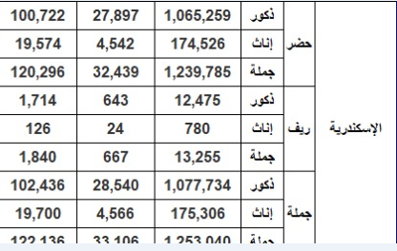
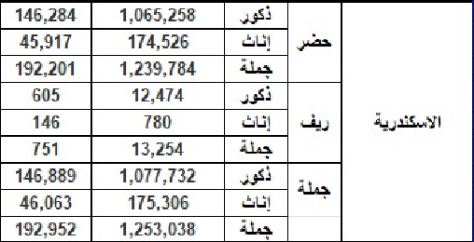
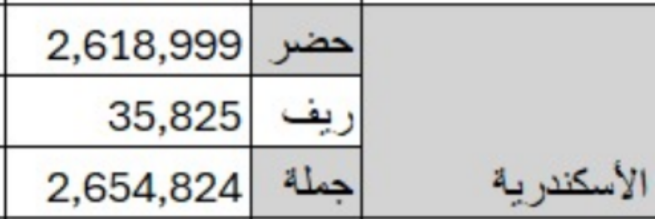
Sample of fuzzy matches we faced

Slide 13
Data Integration

Slide 14
Data Integration
→Our data infrastructure leveraged the strengths of both SQL and
Excel:
SQL Database: Served as the central repository, using a structured star schema with fact and dimension tables to ensure data integrity and relational clarity.
Microsoft Excel: Utilized for final data validation, client-friendly reporting, and creating pivot tables for ad-hoc exploratory analysis.

Slide 15

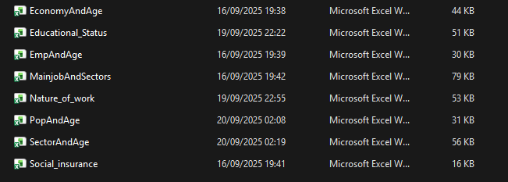
Data Integration: Something to Notice
The phase requires importing 8 final data files into a SQL database for our analysis In Python.
Manually importing such a kind of high volume of files is inefficient and Exhausting doing it one by one.

Slide 16
Data Integration: Something to Notice
The phase requires importing 8 final data files into a SQL database for our analysis In Python.
Manually importing such a kind of high volume of files is inefficient and Exhausting doing it one by one.
✨Here Comes the Beauty of Automation Using Python✨

Slide 17
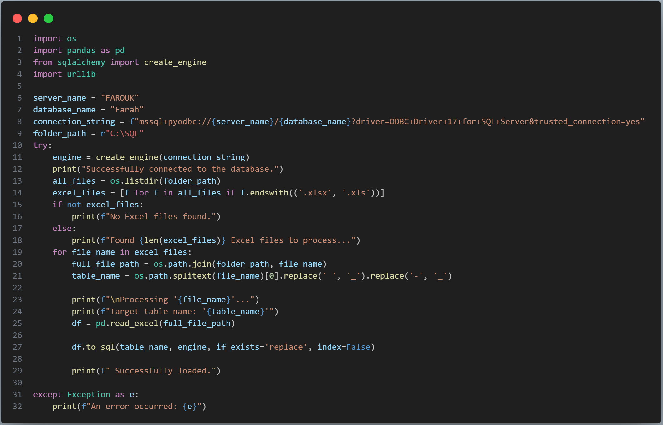
Data Automation

Slide 18
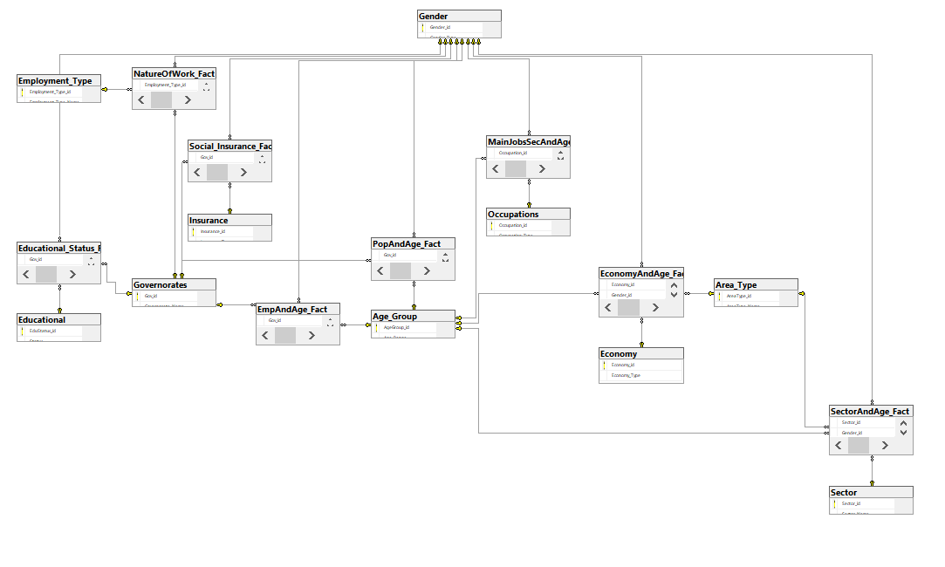
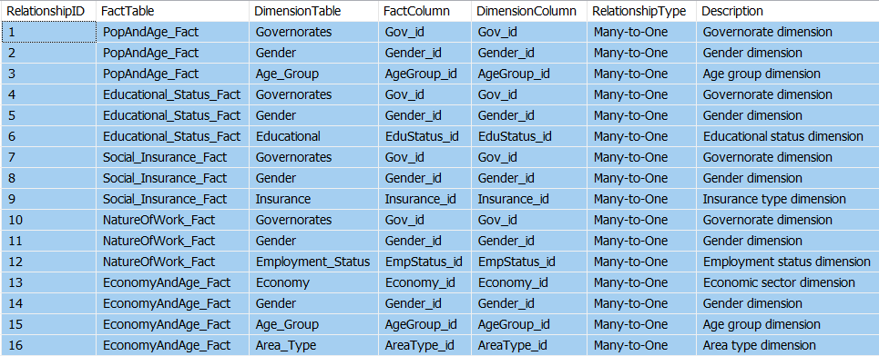
Data Modeling in SQL

Slide 19
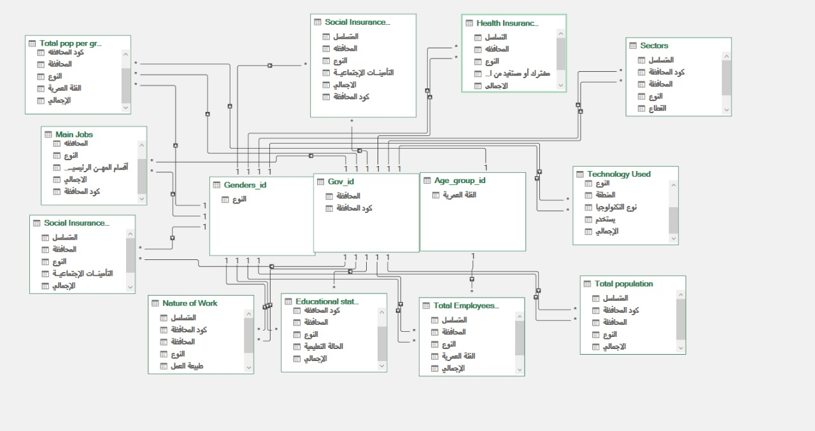
Data Modeling in Excel

Slide 20
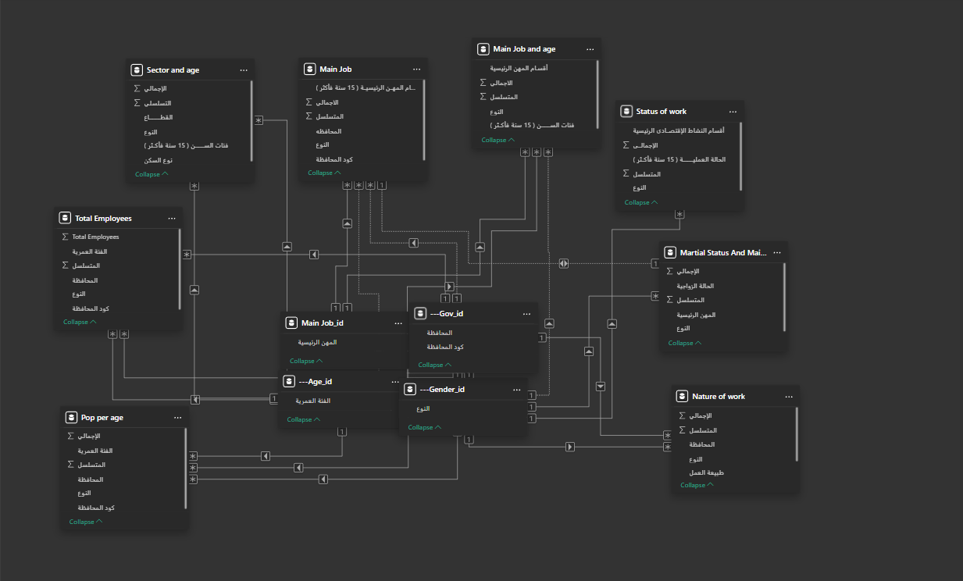
Data Modeling in Power BI

Slide 21
Data Analysis

Slide 22
Data Analysis
Data Analysis: What the Numbers Say
Identified key patterns and trends in workforce distribution
Calculated unemployment rates across demographics and regions
Analyzed correlations between education levels and employment sectors
Used statistical methods to validate findings

Slide 23
Analyzing Data in Excel
Row Labels | Total | Sum of الإجمالي | % لم يكمل تعليمه | % المشاركة
اسوان
ابتدائية | 22205 | 523508 | 84.4% | 4.2%
اعدادية | 39266 | 523508 |  | 7.5%
أمـــــى | 116413 | 523508 |  | 22.2%
تربية فكرية | 801 | 523508 |  | 0.2%
ثانوية عامة / أزهرى | 50201 | 523508 |  | 9.6%
دبلوم عالى | 1433 | 523508 |  | 0.3%
دكتوراه | 588 | 523508 |  | 0.1%
ماجستير | 441 | 523508 |  | 0.1%
محو أمية | 3167 | 523508 |  | 0.6%
مؤهل جامعى | 57312 | 523508 |  | 10.9%
مؤهل فوق متوسط | 21115 | 523508 |  | 4.0%
مؤهل متوسط فنى | 194013 | 523508 |  | 37.1%
يقرأ ويكتب بدون مؤهل | 16551 | 523508 |  | 3.2%
اسيوط
ابتدائية | 46488 | 1087398 | 81.3% | 4.3%
اعدادية | 30064 | 1087398 |  | 2.8%
أمـــــى | 357585 | 1087398 |  | 32.9%
تربية فكرية | 952 | 1087398 |  | 0.1%
ثانوية عامة / أزهرى | 63557 | 1087398 |  | 5.8%
دبلوم عالى | 2589 | 1087398 |  | 0.2%
دكتوراه | 2311 | 1087398 |  | 0.2%
ماجستير | 2147 | 1087398 |  | 0.2%
محو أمية | 3962 | 1087398 |  | 0.4%
مؤهل جامعى | 155997 | 1087398 |  | 14.3%
مؤهل فوق متوسط | 39159 | 1087398 |  | 3.6%
مؤهل متوسط فنى | 346205 | 1087398 |  | 31.8%
يقرأ ويكتب بدون مؤهل | 36380 | 1087398 |  | 3.3%
Row Labels | Total emp | Not insured emp | %of n.i emp
اسوان
غير مشترك وغير مستفيد | 523508 | 368179 | 70.3%
اسيوط
غير مشترك وغير مستفيد | 1087398 | 738965 | 68.0%
الإسكندرية
غير مشترك وغير مستفيد | 1253040 | 715503 | 57.1%
الإسماعيلية
غير مشترك وغير مستفيد | 327857 | 179973 | 54.9%
الاقصر
غير مشترك وغير مستفيد | 349740 | 220102 | 62.9%
البحر الأحمر
غير مشترك وغير مستفيد | 83328 | 31935 | 38.3%
البحيرة
غير مشترك وغير مستفيد | 1592699 | 1069244 | 67.1%
الجيزة
غير مشترك وغير مستفيد | 2045519 | 1297800 | 63.4%
الدقهلية
غير مشترك وغير مستفيد | 1638440 | 1068253 | 65.2%
السويس
غير مشترك وغير مستفيد | 193331 | 87949 | 45.5%
الشرقية
غير مشترك وغير مستفيد | 1670933 | 977656 | 58.5%
الغربية
غير مشترك وغير مستفيد | 1313345 | 760607 | 57.9%
الفيوم
غير مشترك وغير مستفيد | 932099 | 688921 | 73.9%
القاهرة
غير مشترك وغير مستفيد | 2297541 | 1240106 | 54.0%
القليوبية
غير مشترك وغير مستفيد | 1273444 | 674630 | 53.0%
المنوفية
غير مشترك وغير مستفيد | 1185060 | 621921 | 52.5%
المنيا
غير مشترك وغير مستفيد | 1429507 | 1036046 | 72.5%
الوادى الجديد
غير مشترك وغير مستفيد | 74724 | 27665 | 37.0%
Row Labels | Total pop | Total emp | %of employees
اسوان
<15 | 142501 | 21434 | 15.0%
اسيوط
<15 | 467228 | 54560 | 11.7%
الإسكندرية
<15 | 446039 | 33106 | 7.4%
الإسماعيلية
<15 | 121333 | 11587 | 9.5%
الاقصر
<15 | 121070 | 11043 | 9.1%
البحر الأحمر
<15 | 29873 | 769 | 2.6%
البحيرة
<15 | 546965 | 58215 | 10.6%
الجيزة
<15 | 806544 | 69264 | 8.6%

Slide 24
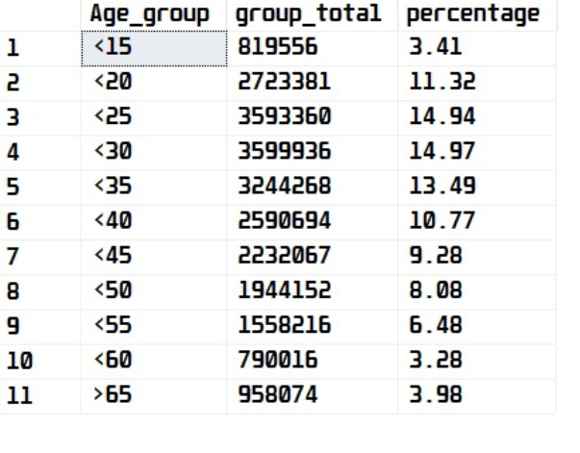
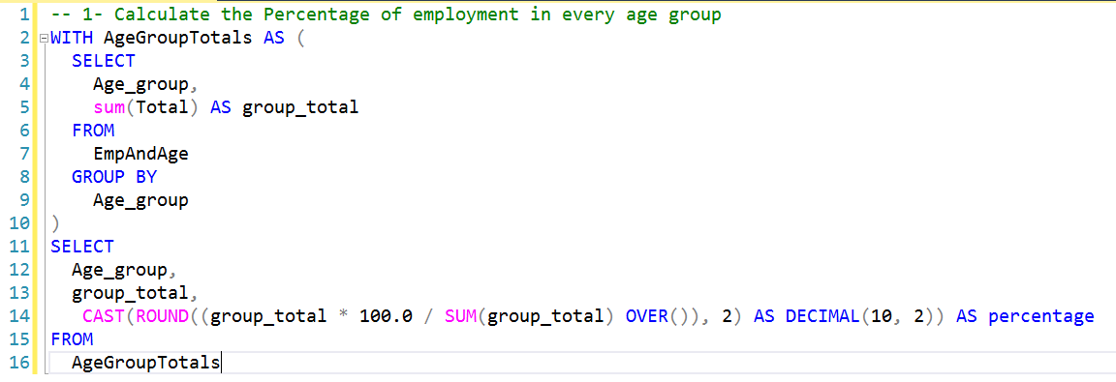
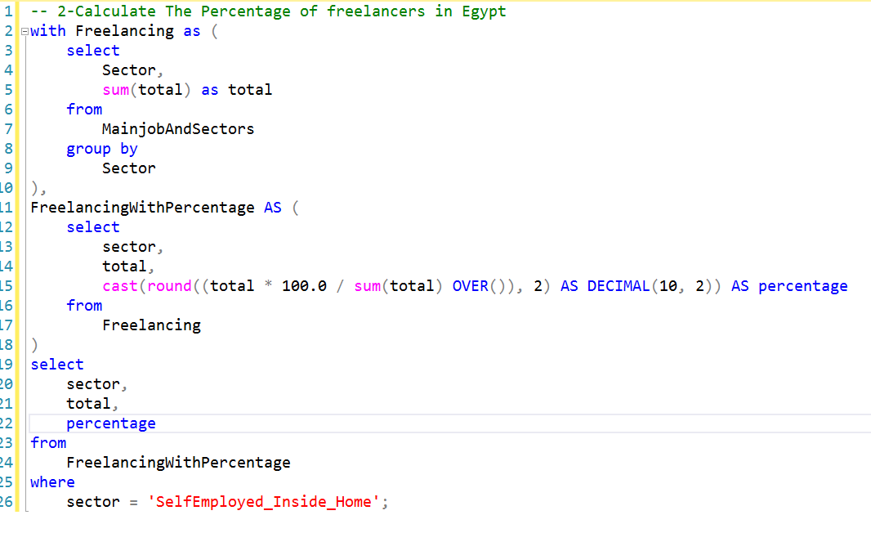
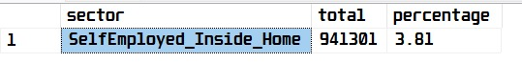
Analyzing Data in SQL

Slide 25
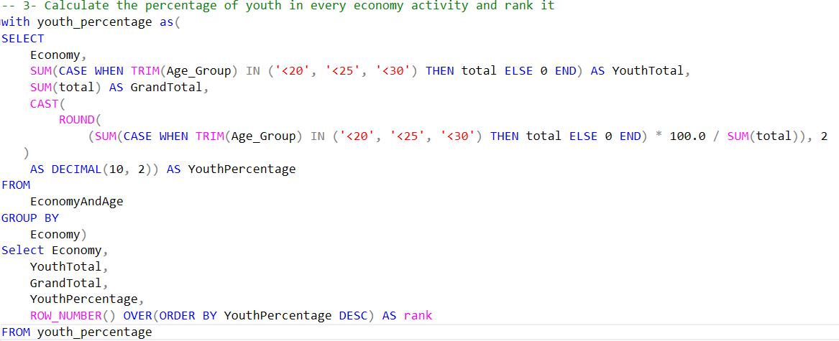
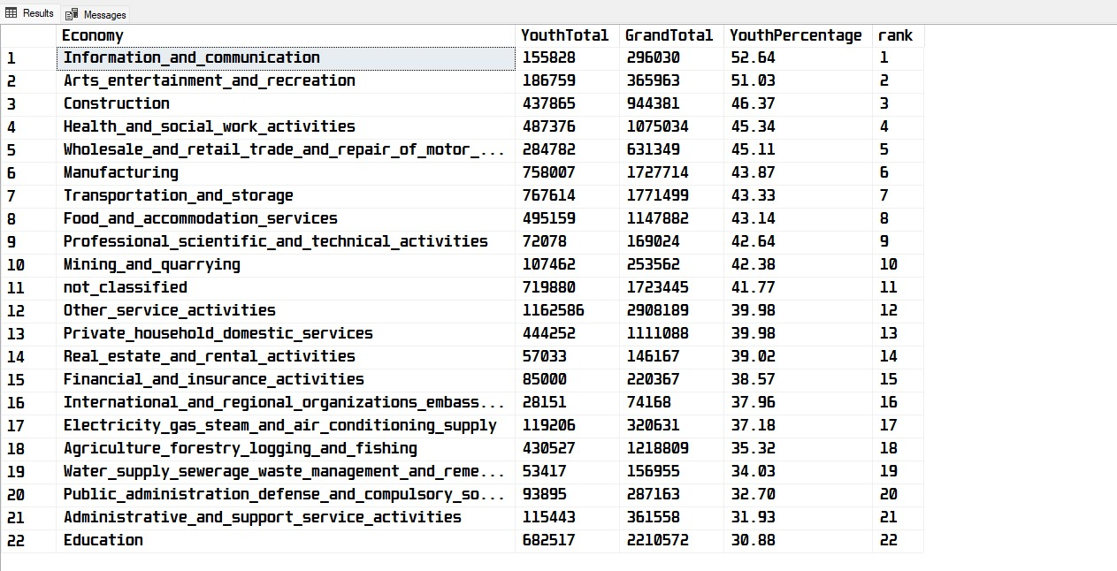
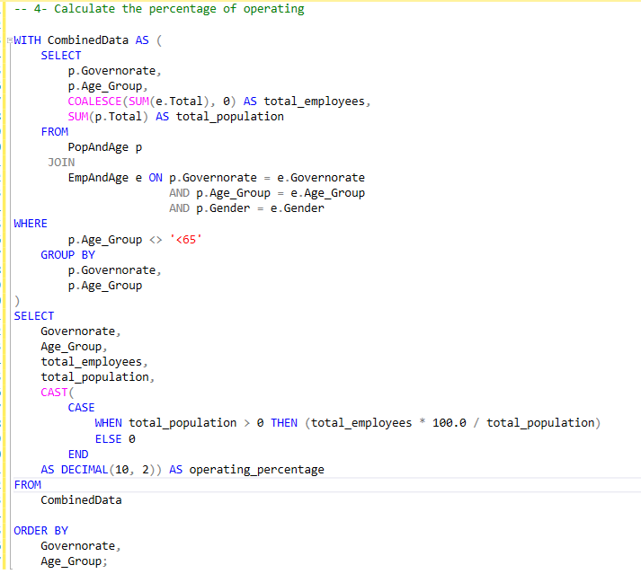
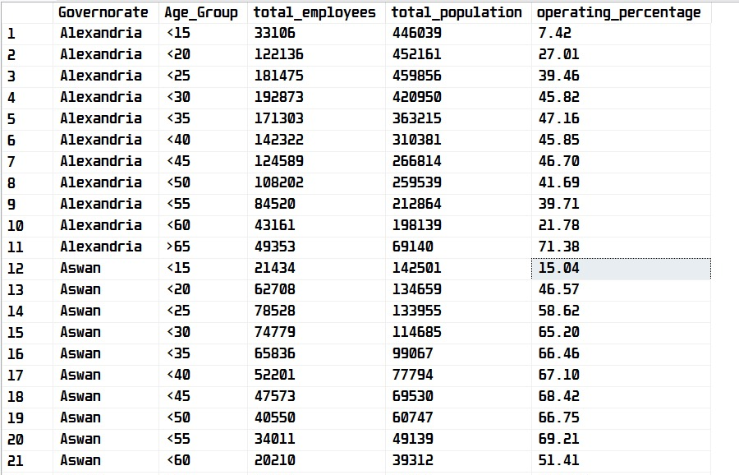
Analyzing Data in SQL

Slide 26
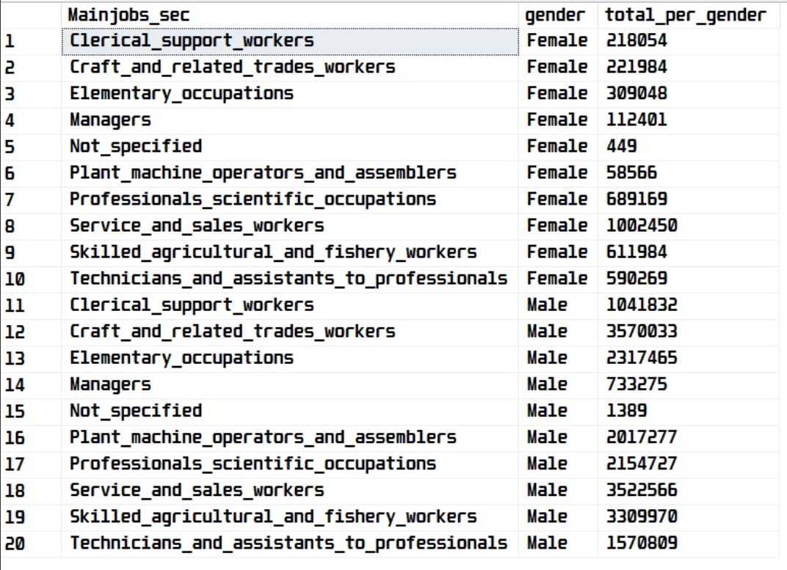
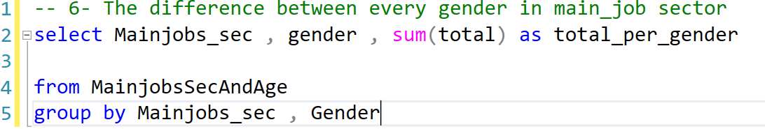
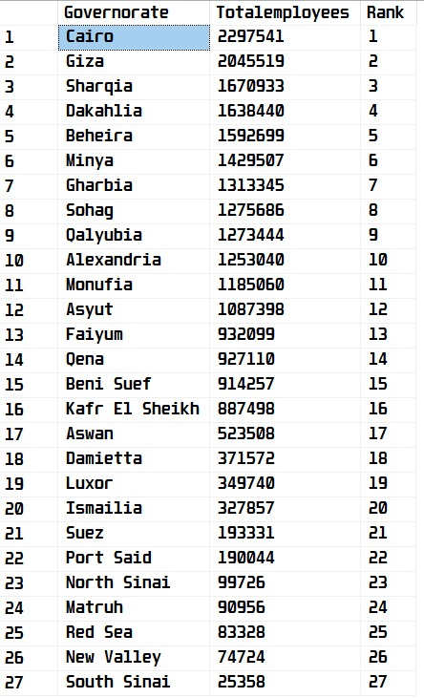
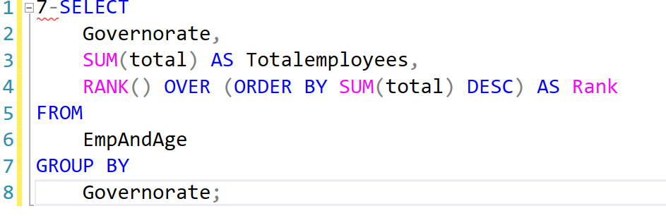
Analyzing Data in SQL

Slide 27
Data Visualization

Slide 28
Data Visualization
We divided our data into three categories:

Slide 29
Data Visualization
We divided our data into three categories:

Slide 30

Data Visualization
We divided our data into three categories:

Slide 31

Data Visualization
We divided our data into three categories:

Slide 32
1- Workforce in Egypt
From Data to Insight: Our Visualization Stack
We transformed complex workforce data into clear, interactive narratives using a multi-tool approach:
→Power BI: For interactive dashboards
On employment and demographics.
→ Tableau: For dynamic maps and regional trend analysis.
→ Python: For advanced, custom statistical plots.

Slide 33
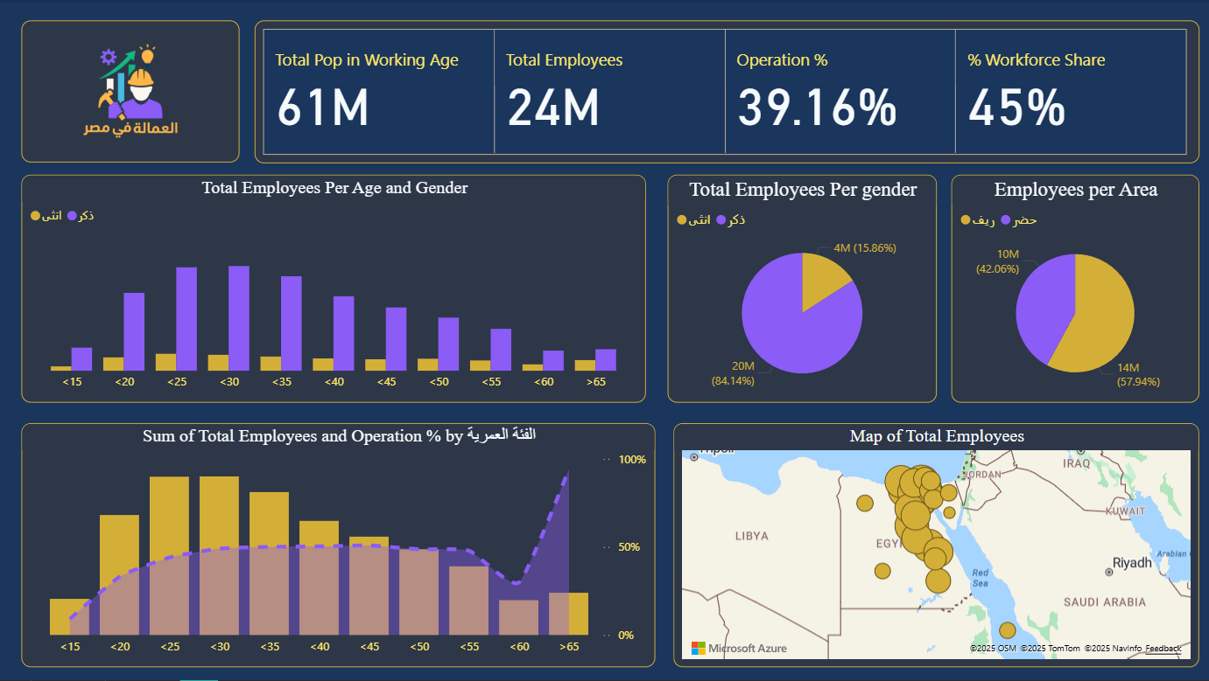

Slide 34
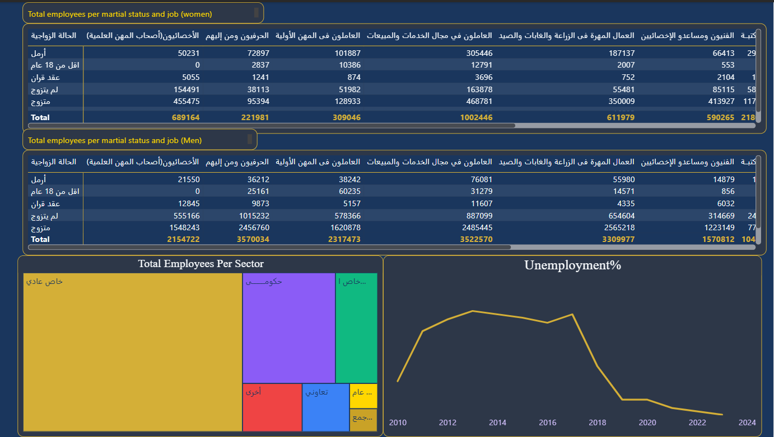

Slide 35
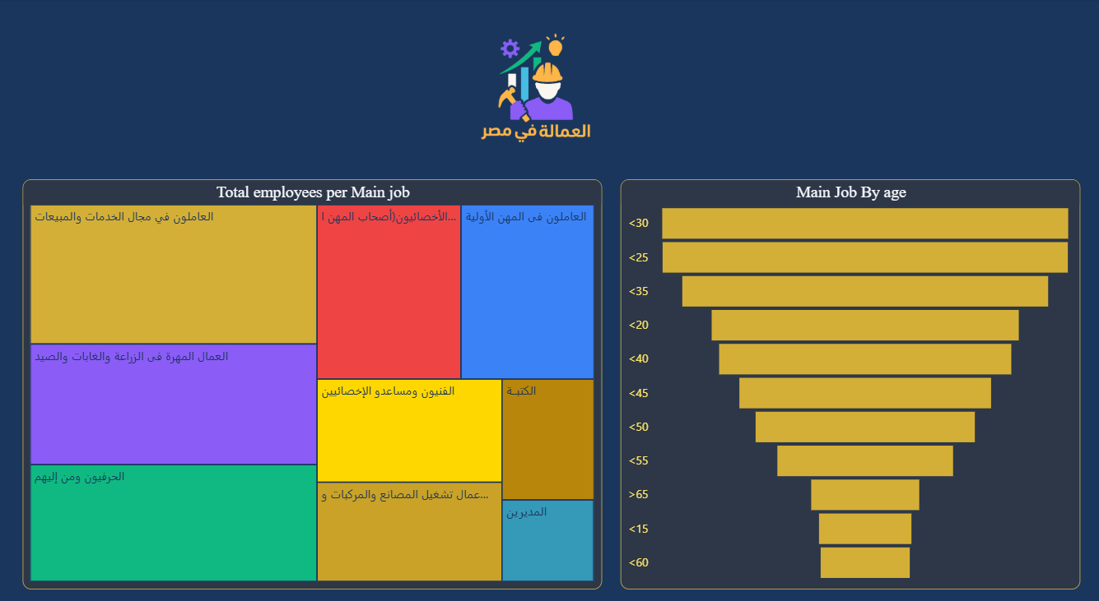

Slide 36
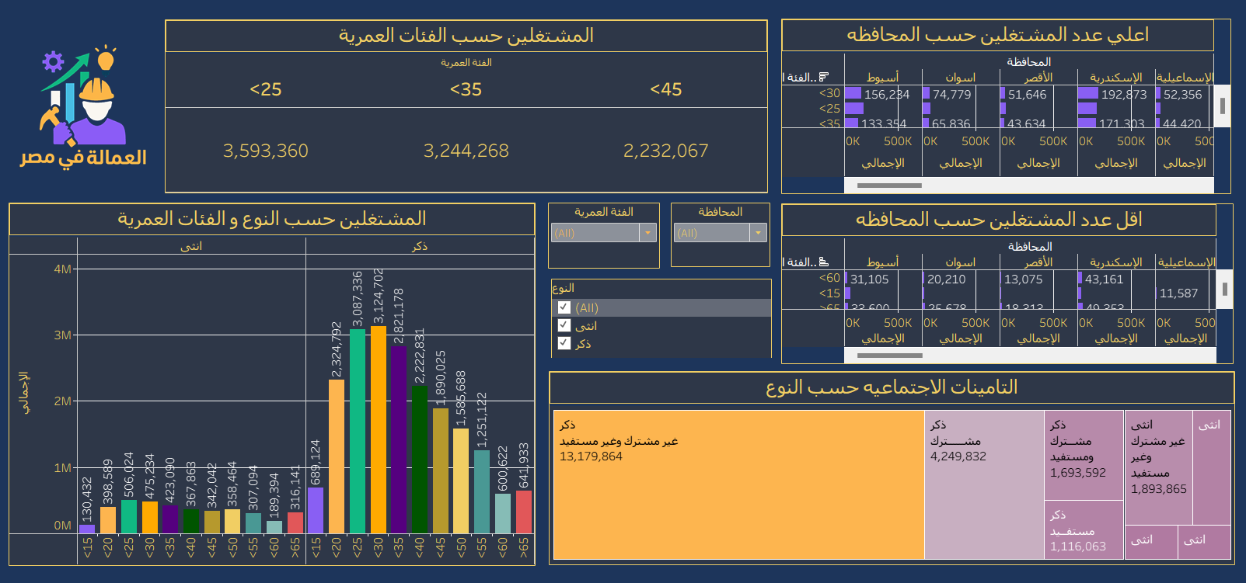

Slide 37
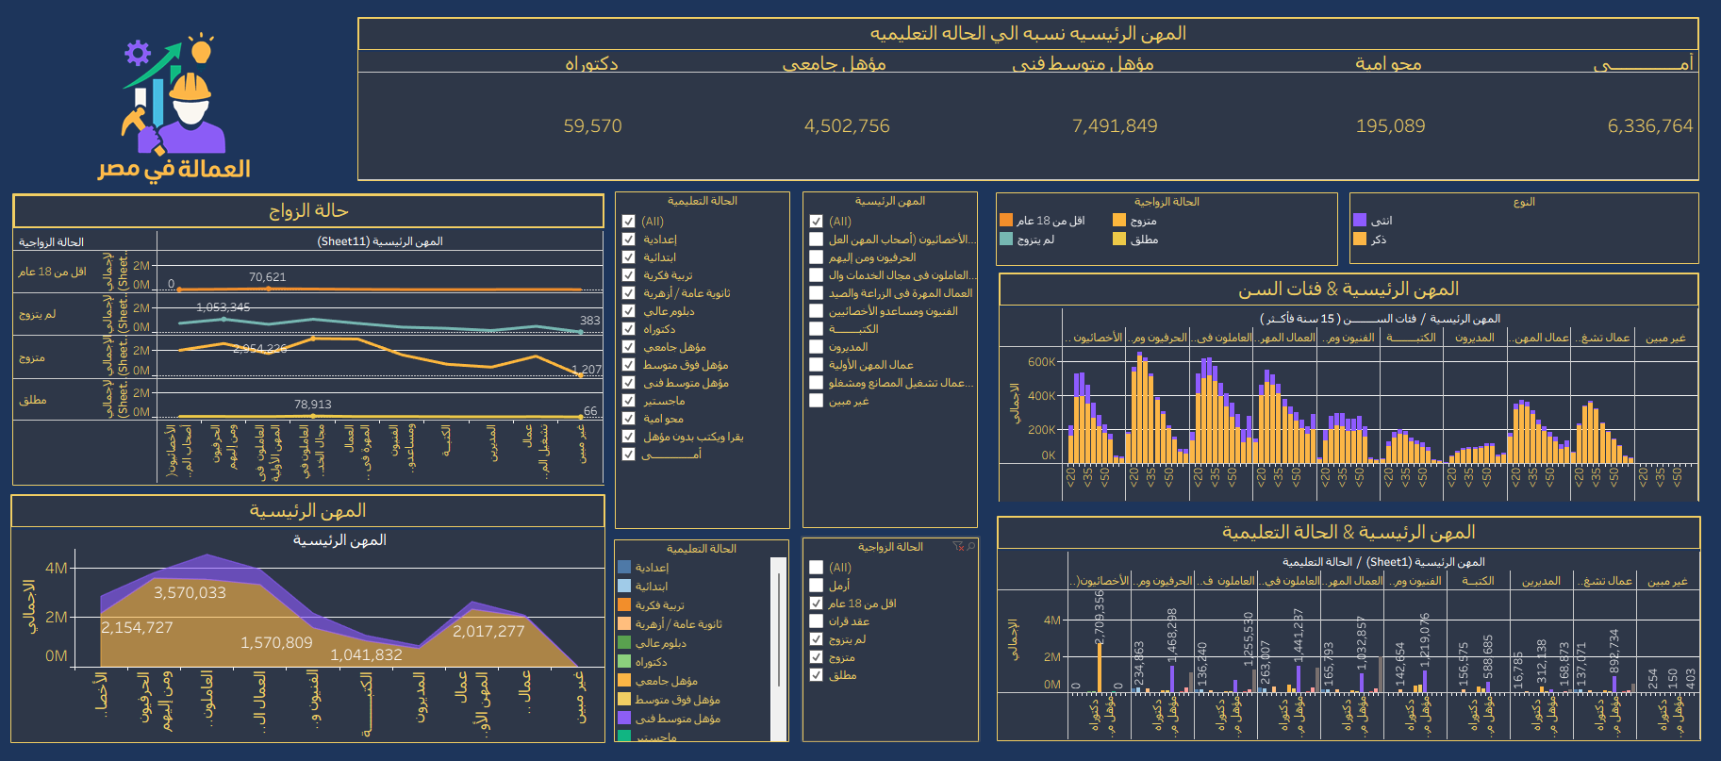

Slide 38
2- Education in Egypt
Education & The Labor Market
Our analysis focuses on the critical link between learning and earning in Egypt:
Employment by Education: How different educational levels correlate with job status, income, and sector.
The Skills Gap: Measuring the mismatch between graduate skills and market demands.
New Pathways: The impact of vocational training and certifications on employment and the freelance economy.

Slide 39
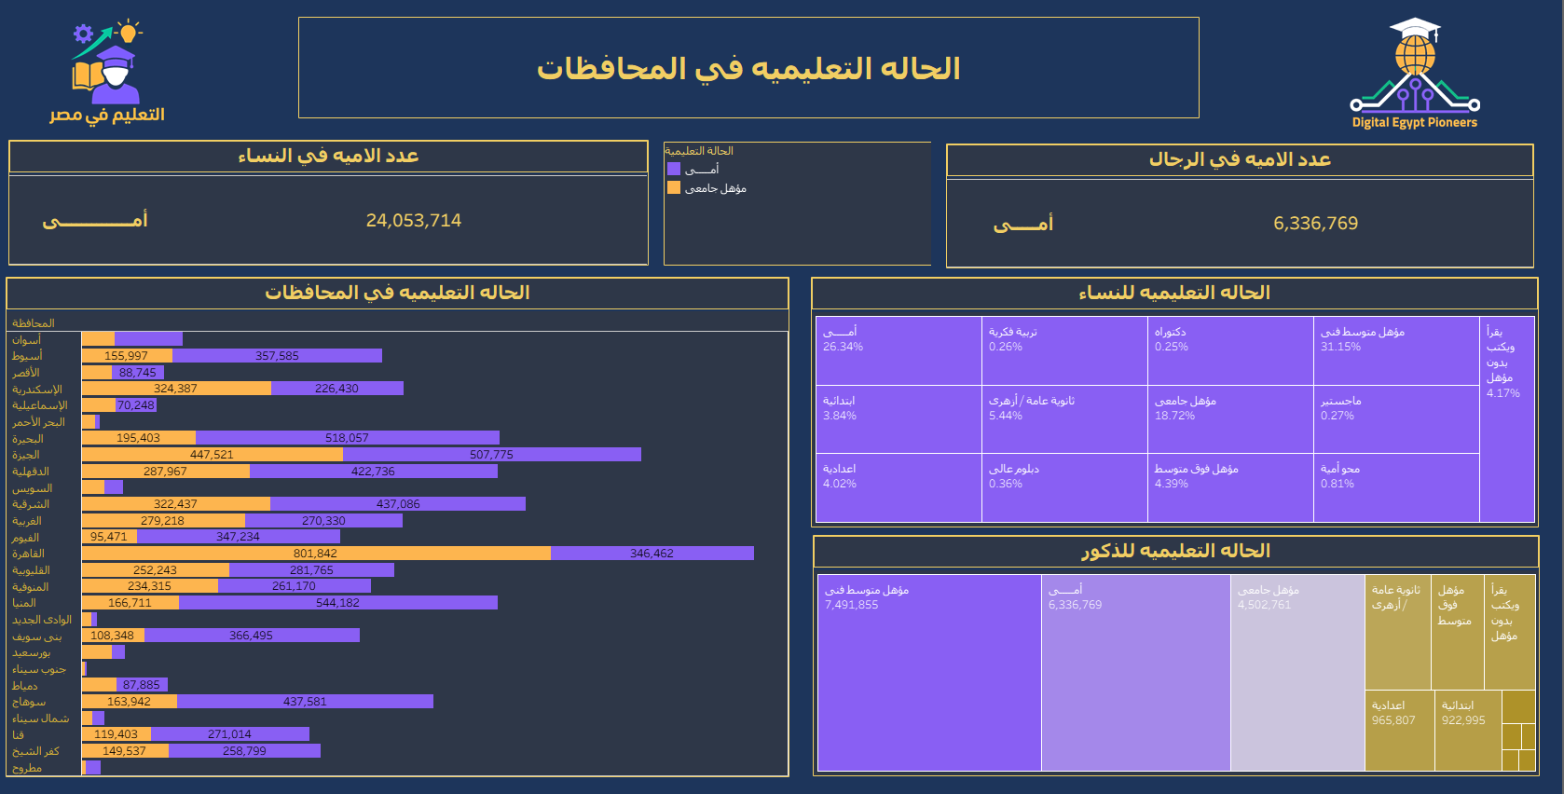

Slide 40
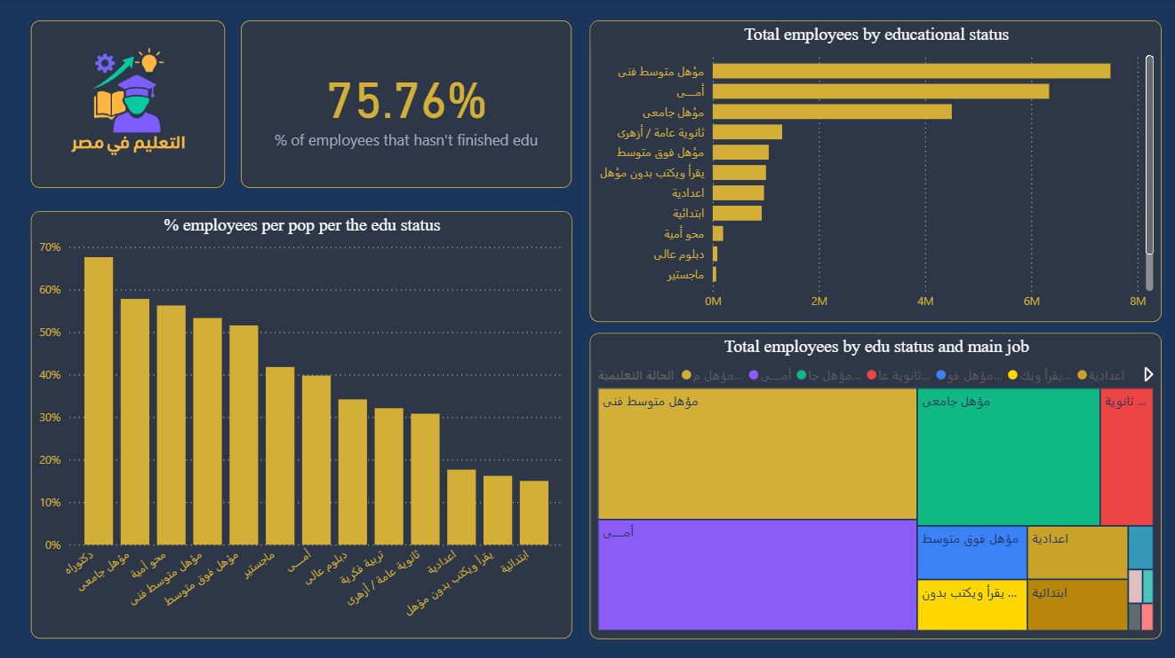

Slide 41
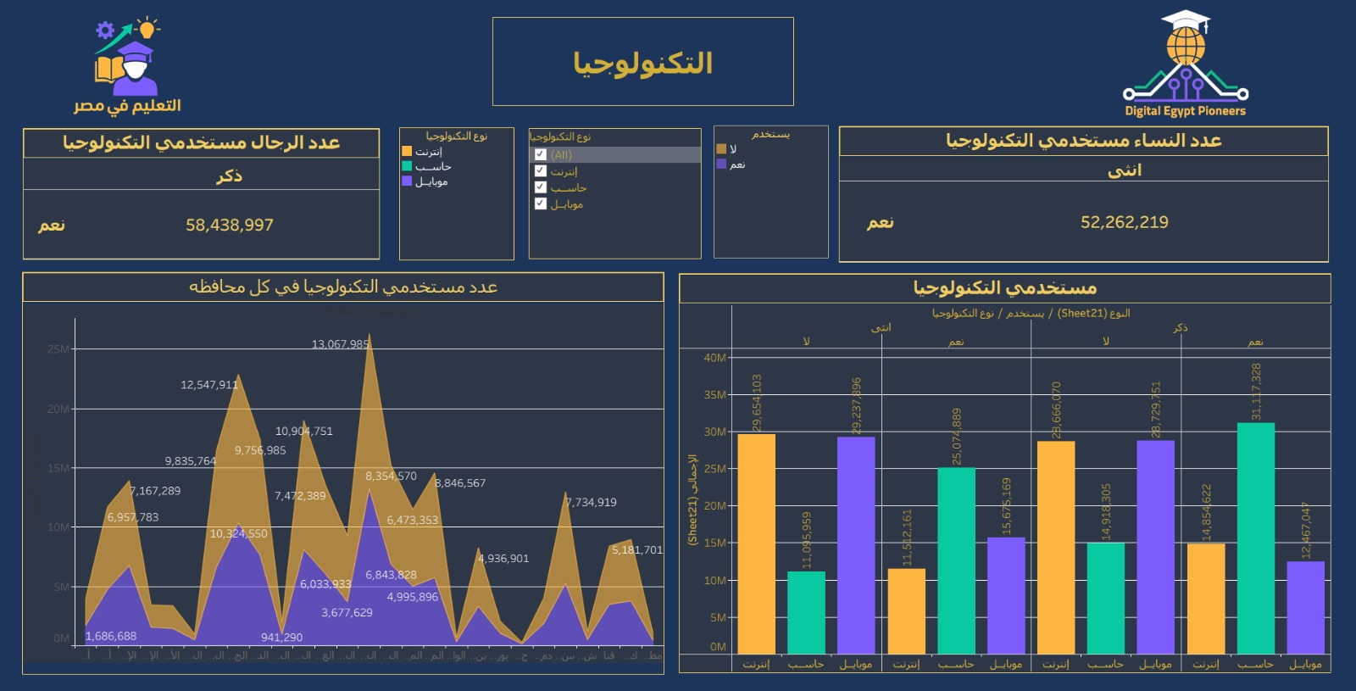

Slide 42
3- Freelancing in Egypt
The Gig Economy in Egypt
We analyzed freelancing as a vital part of the modern workforce:
Rapid Growth: Tracking the year-over-year surge in freelancers and popular platforms.
Top Skills: Identifying high-demand fields like tech, digital marketing, and content creation.
Key Demographics: Visualizing the age, location, and education of freelancers.
Economic Impact: Measuring its role in youth employment and supplemental income.

Slide 43
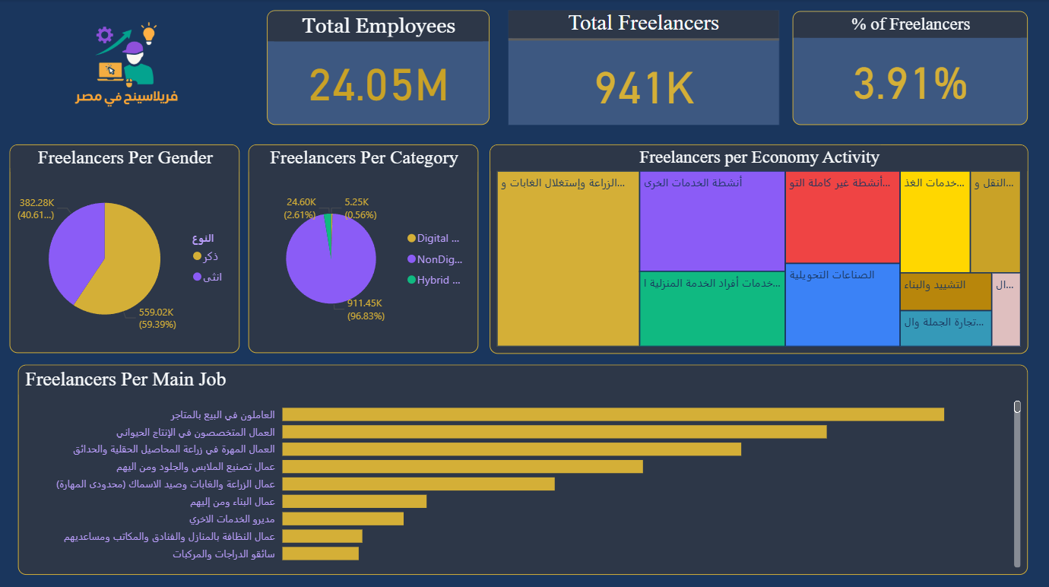

Slide 44
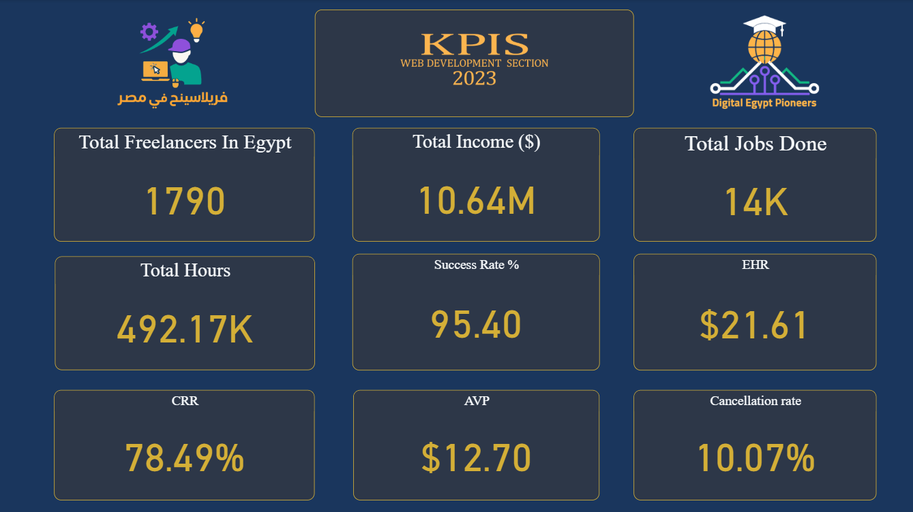

Slide 45
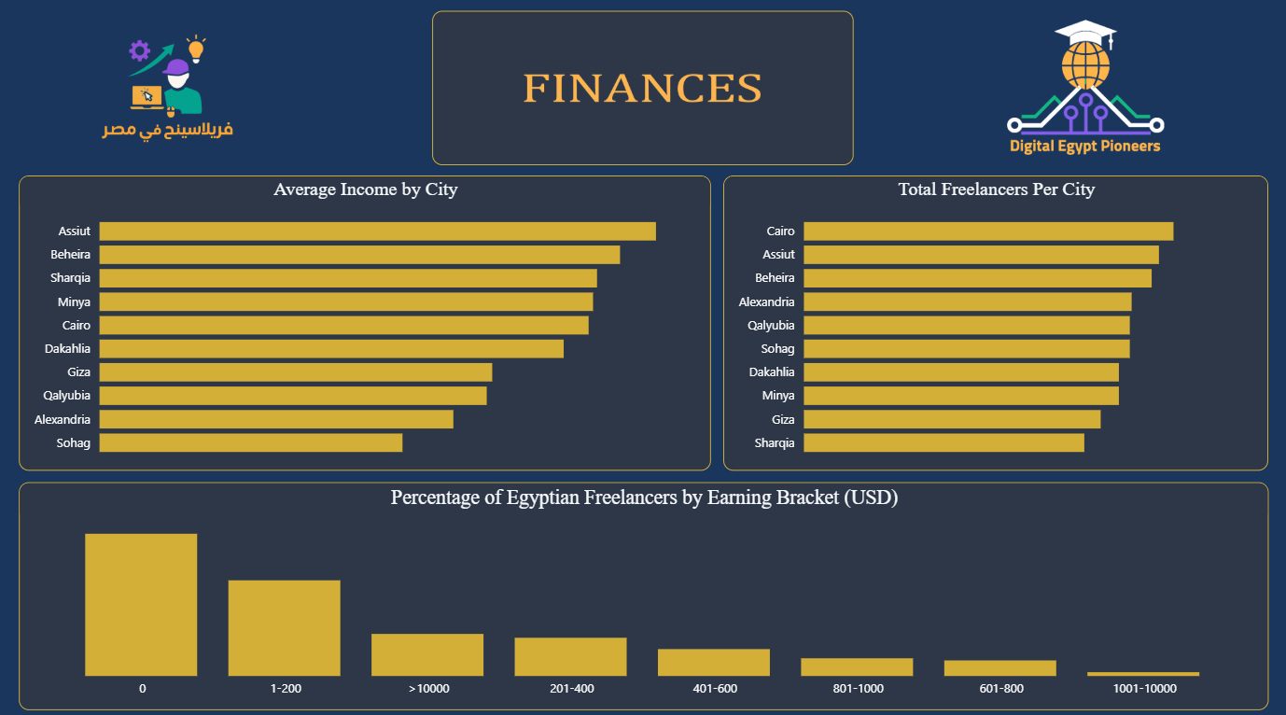

Slide 46
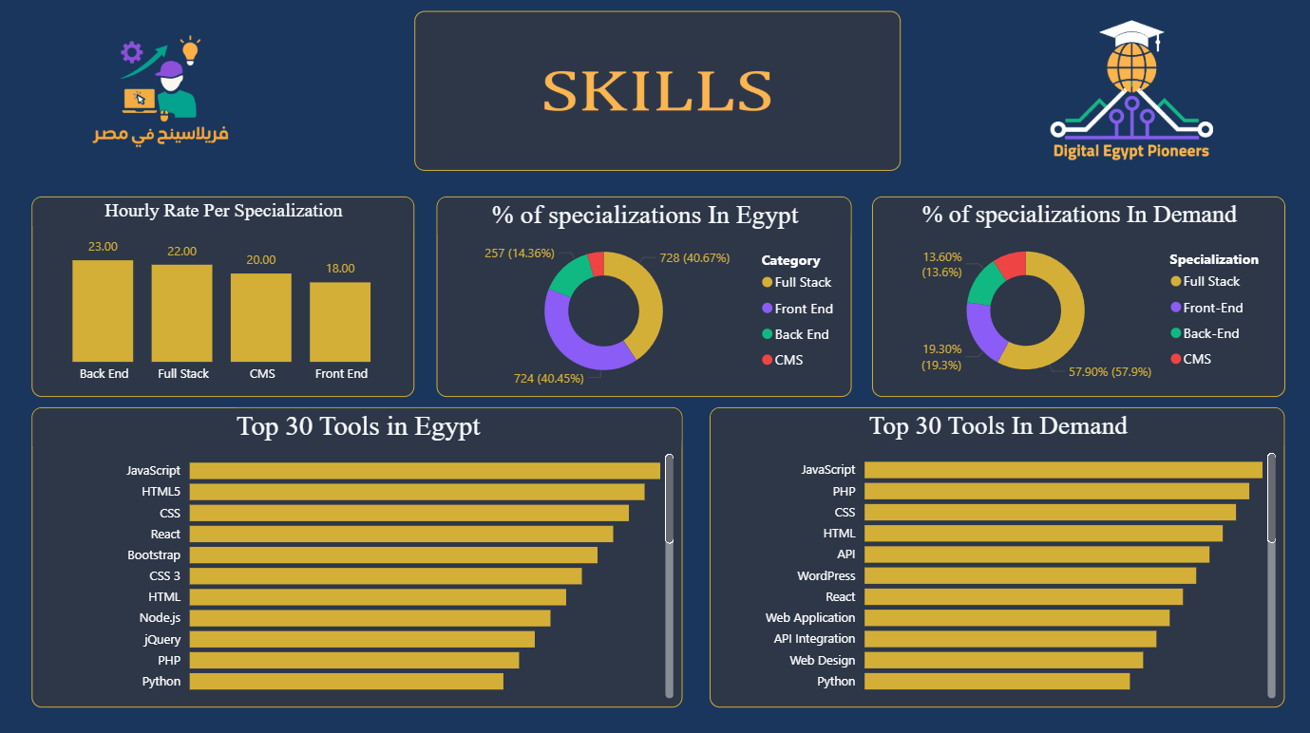

Slide 47
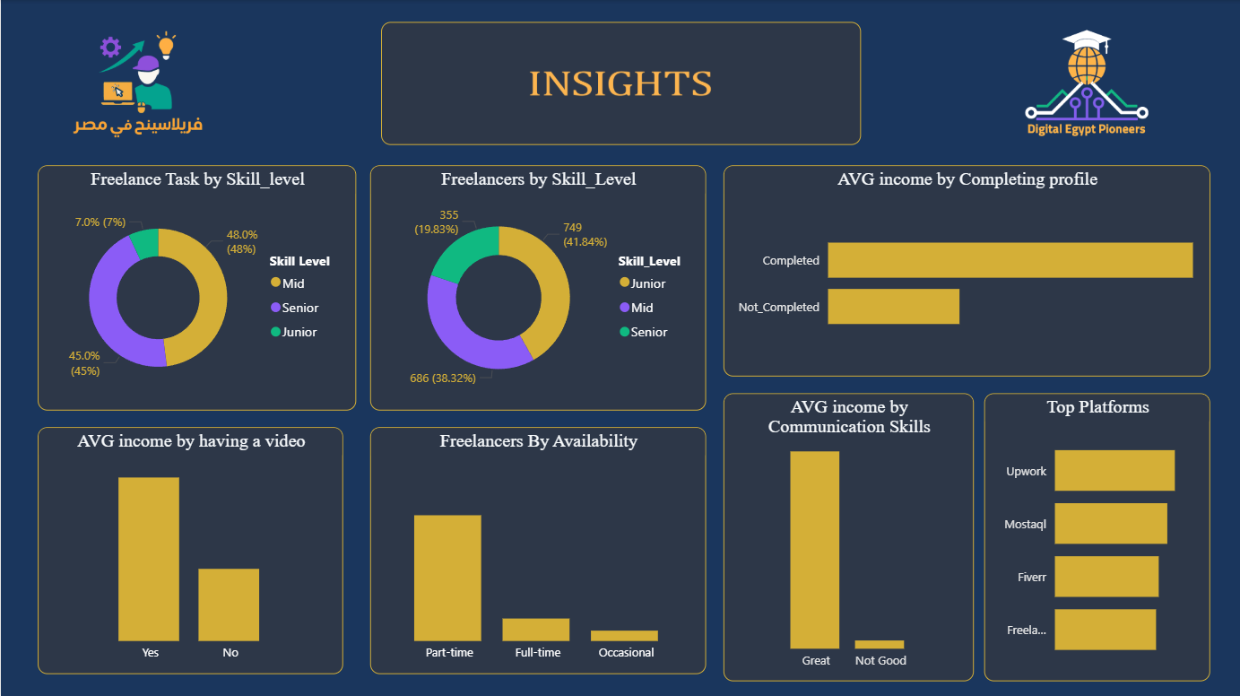

Slide 48


Combining the Overview with The Beauty of Python

Slide 49
The Act phase
1- Increase the female operation ratio by 5% within 18 months.
2-Subsidized or Free Training Programs: Offer accessible, subsidized, or free training and upskilling programs for employees, particularly those in vulnerable sectors or those who are undereducated. This should include both technical and essential 'soft skills' (communication, teamwork, adaptability)
3- It is essential to recognize and spread awareness that every freelancer has the right to compensation for their work, irrespective of the project's scale or duration. All services delivered represent valuable professional effort.
4- Providing personal computing solutions for the contemporary general user at a reasonable price.
5-Our objective is to bridge the skills gap by offering comprehensive internship opportunities that equip all participants with the core proficiencies of future-proof careers.

Slide 50
Things only get better thru change, not chance.

Slide 51

Thank You

